Slide 1
MNIST and machine learning
CLASSIFICATION OF HANDWRIT TEN DIGITS BY A SIMPLE LINEAR
MODEL
A presentation by Arvind Kumar

Slide 2
MNIST data-set
Goal:
Train a model
Look at images
Predict what digits they are.
General approach and explanations on how to use machine learning
Relation to Data Science:
A lot of data needed to train the model
Classify future input images
Find characterization of each digit
MNIST AND MACHINE LEARNING
2

Slide 3
MNIST data-set

Slide 4
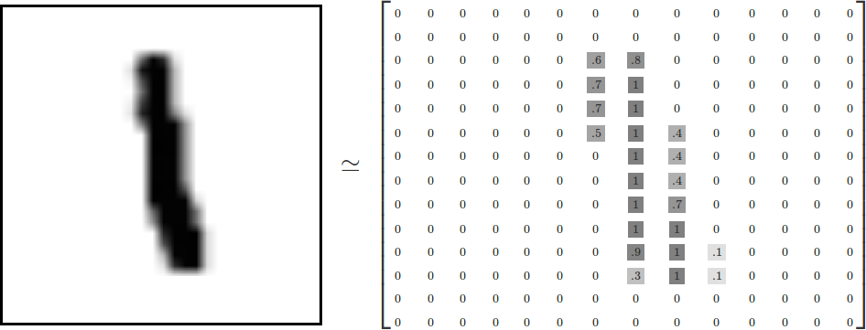
MNIST data-set
28x28 pixel images of hand-written digits
Every image can be thought of as an array of numbers between 0 and 1 describing how dark each
pixel is (intensity of pixel)

Slide 5
MNIST data-set
Not all arrays are MNIST digits:
Randomly pick a few points
Each pixel is randomly black, white or some shade of gray
We most probably get a noisy image
The data-set is split into 3 mutually exclusive sub-sets.
Training data (55000 images used to train the algorithm)
Test data (10000 images used to test the algorithm)
Validation data (5000 images used to optimize algorithm)
In machine learning we need separated data:
To make sure that what we've learned actually generalizes
Test data:
Used to test the algorithm, not to optimize or improve the algorithm

Slide 6
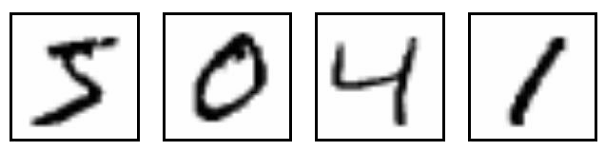
MNIST data-set
Every MNIST data point has two parts:
Image of a handwritten digit
Corresponding label (number between 0 and 9) representing the digit drawn in the image.
The labels for the above images are 5, 0, 4, and 1.
This label will be used to compare the predicted digit (by the model) with the true digit (given by the data)

Slide 7
Weights

Slide 8
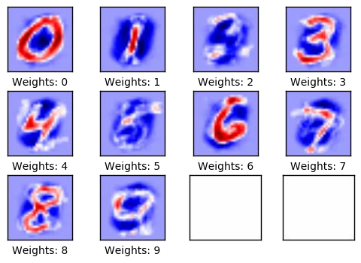
Weights
Goal of the model:
In order to distinguish the images, we will need a
filter.
Better filter ⇒ Better detection of handwritten
digits.
The following diagram shows an example of the weights (the filter) one model learned for each of these classes.

Slide 9
Weights
The weight is a matrix, for each digit, which
stores a value for each pixel.
The weight of a pixel is
negative, if that pixel has a high evidence
against the image being in that class
positive, if it is evidence in favor.

Slide 10
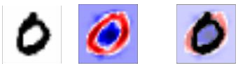
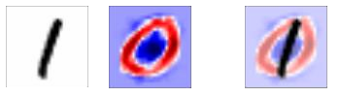
Evaluation of the model
Example:
The weights used to determine if an image shows a 0-digit have a
positive reaction to an image of a circle
negative reaction to images with content
in the center of the circle.

Slide 11
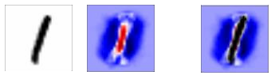
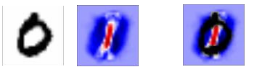
Evaluation of the model
Example:
The weights used to determine if an image shows a 1-digit react
positively to a vertical line in the center of the image
negatively to images with content
surrounding that line.

Slide 12
Weights
Positive weight = pixel should not be 0 at that
position.
The higher the weight, the closer to 1 the pixel intensity should be
Negative weight = pixel should be 0 at that position.
The lower the weight, the closer to 0 the pixel intensity should be

Slide 13
Weights
If there is a none zero pixel at a position with negative weights, then this contributes to not being that number.
If there is none zero pixel at a position, where there are positive weights, then it contributes to being that number.
Weight matrix describes for each digit where the usual non zero pixels should be

Slide 14
Weights
To measure the evidence of a digit being in one class, one computes a weighted sum of the pixel itensities:
Each image is an array of values between 0 and 1
Each filter has a weight for each pixel
Multiply each pixel’s intensity with its
corresponding weight and compute the sum

Slide 15
Weights
For ONE handwritten digit, we compute a weighted sum with respect to EACH filter
We get 10 different values representing the
evidences for being each digit
For independence, we add some extra evidence, called a bias, to the weighted sum.
Since linear model, we do not necessarily want
the line to go through the origin

Slide 16

Weights
The evidence for a class i (i.e. being the digit i) given an input x (the image) is:
We multiply the images variable x with the weights and then add the biases.
W_{i} is the weight for class i
b_{i} is the bias for class i
j is an index for summing over the pixels in our input image x.

Slide 17
Weights
These evidences are difficult to interpret, because the numbers may be very small or large, positive or negative.
Every image in MNIST is of a handwritten digit between 0 and 9.
So there are only 10 possible things that a given image can be.
For each image, we want to give the probabilities for it being each digit.
Hence, we want to normalize the evidences, so that all the evidences for one image sum up to 1
and each element is limited between 0 and 1 (data transformation).
Converting evidences into a probability distribution over 10 cases representing probabilities of our input being in each class.

Slide 18
Weights
For example:
Our model might look at a picture of a 9 and output
an 80% chance of being a 9
a 5% chance of being an 8 (because of the top loop)
a bit of probability to all the others because it isn't 100% sure.

Slide 19
Weights
Convert the evidences into (predicted) probabilities using the softmax function:
From this, we can get the predicted class of our handwritten digit by taking the label of the
largest element.
Hence, we take the highest probability for being in a specific class, which will represent the
prediction of the handwritten digit.
For the previous example, this will be the digit 9, since it has a 80% chance.

Slide 20
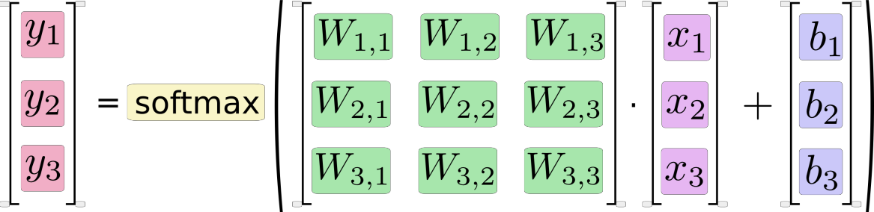
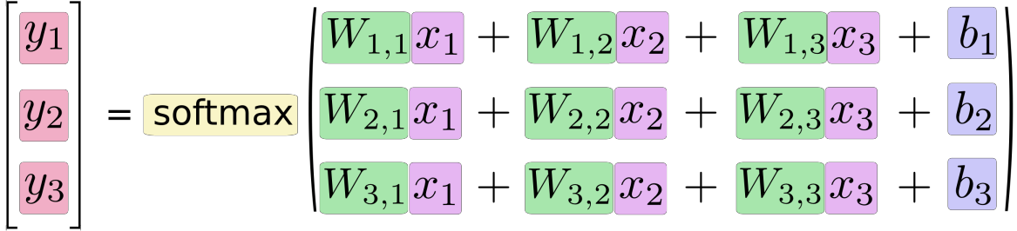
Weights
The element of the i'th row is an estimate of how likely the input image is to be of the i'th class.

Slide 21
Weights
Remember: The weights and biases represent the filter .
In order to make the model better at classifying the input images, the machine learning part will try to
change the weights and biases
optimize them
But first, we need to know how well the model currently performs:
Compare the predicted output of the model to the desired output.

Slide 22
Training

Slide 23
Training
In our case, training means to get a better filter, so that we can distinguish the handwritten digits better.
We need a definition
to describe what it means for the model to be good.
or to describe what it means for a model to be bad (typically used in machine learning).
We call this the cost
It represents how far off our model is from our desired outcome.
We try to minimize that error/cost
the smaller the error margin, the better our model is.

Slide 24

Training
To determine the cost of our model, we are using a function called cross-entropy:
Where
y is our predicted probability distribution and
y’ is the true distribution for one handwritten digit.
The cross-entropy is measuring how inefficient our predictions are for describing the truth.

Slide 25
Training
The cross-entropy
is a performance measure used in classification.
is a function that is always positive.
equals zero, if the predicted output of the model exactly matches the desired output.
The goal of our training is to minimize the cross-entropy so it gets as close to zero as possible.
How to use the cross-entropy:
Calculate the cross-entropy for each of the image classifications
To get a measure of how well the model performs on each image individually.
Take the average of the cross-entropy for all the image classifications
We need a single scalar value to define the performance of our model

Slide 26
Training
The preceding procedure gives us a cost function, which we want to minimize in order to get a better model.
To minimize the cross-entropy one can use the gradient descent algorithm (see numerical
analysis).
Gradient descent is an algorithm, where it
shifts each variable a little bit in the direction that reduces the cost.
adjusts the current weights and biases .
uses a learning rate of 0.5.
Consequently, it minimizes the mean of the entropies for the images which we used to train!

Slide 27
Training
In machine learning, and especially in TensorFlow, the model:
is represented by a graph, which stores all the computations
can use the backpropagation algorithm to efficiently determine how your variables (weights and biases) affect the cost you ask it to minimize.
Backpropagation is a common method of training artificial neural networks used in combination with an optimization method (here: gradient descent).
Meaning:
Calculate the gradient of a cost function (cross-entropy)
Go back in the model
Adjust parameters (weights and biases) in order to optimize the cost function at the current state.

Slide 28
Training
There are 55.000 images in the training-set. It takes a long time and it is expensive to calculate
the gradient of the model using all these images.
It is better to do an iteration:
Use a small batch of images (for example 100) in each iteration of the optimizer
Use a new subset every time. Doing this is cheap and has much of the same benefit as taking all images.
Execute the optimizer using those 100 training samples.
gradually improve the weights and biases of the model.
Repeat this procedure a lot of times.
adapt and generalize the weights for all different kind of handwritten images.
Using small batches of random data is called stochastic training

Slide 29
Training
Summary of the training phase:
Calculate the entropy of the predicted and true digit.
Calculate the mean over all the entropies (measure of performance).
Minimize the mean (0 means that all our predictions are correct).
Use the gradient method to minimize the cost.

Slide 30
Evaluation of the model

Slide 31
Evaluation of the model
We want to check where we predicted the correct label.
For each image (of the test data!):
Check if the predicted digit is the same as the true digit
This gives us a vector of Booleans
Transform the Booleans into numbers
False becomes 0
True becomes 1
Calculate the average of these numbers.
Calculate the accuracy of the model
For example:
[True, False, True, True] would become [1,0,1,1]
The average is 0.75
Hence our accuracy is 75%.

Slide 32
Evaluation of the model
After no optimization iteration, the accuracy on the test-set is 9.8%.
This is because the model has only been initialized and not optimized at all:
At the initial step, the weights and biases are 0.
All the evidences will become zero and we get 10 zero values.
Softmax will output [0.1 , … , 0.1].
The maximum of this is 0.1 (the maximum will take the first digit since all are equal).
All the images are predicted as 0.
It always predicts that the image shows a 0 digit and it turns out that 9.8% of the images in the
test-set happens to be 0 digits.

Slide 33
Evaluation of the model
The weights for our model after 1 iteration:
The model has increased its accuracy on the
test-set to 40% up from 9.8%.
The weights mostly look like the digits they're supposed to recognize. This is because only 1 optimization iteration has been performed.
The weights are only trained on 100 images.
After training on several thousand images, the weights become more difficult to interpret, because they have to recognize many variations of how digits can be written.

Slide 34
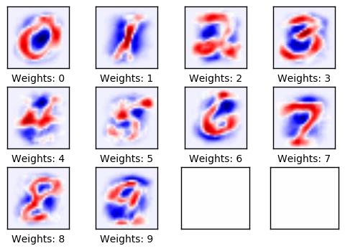
Evaluation of the model
The weights for our model after 10 iterations:

Slide 35
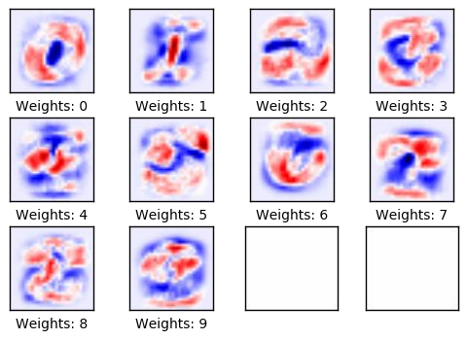
Evaluation of the model
The weights for our model after 1000 iterations:
The model has increased its accuracy on the test- set to 91%.
The model has been trained for 1000 optimization iterations, with each iteration using 100 images from the training-set.
Because of the great variety of the images, the weights have now become difficult to interpret.
We may doubt whether the model truly understands how digits are composed, or whether the model has just memorized many different variations of pixels.

Slide 36
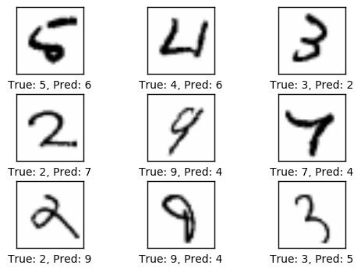
Evaluation of the model
Some of the misclassified digits after having
trained the model by 1000 iterations:
Some of the misclassifications are justified, because the images are very hard to determine with certainty even for humans, while others are quite obvious and should have been classified correctly by a good model.
But this simple model cannot reach much better performance and more complex models are therefore needed.

Slide 37
Evaluation of the model
This simple linear model had about 92% classification accuracy for recognizing hand-written
digits in the MNIST data-set.
Is that good? No, it's pretty bad! This is because we're using a very simple model.
A simple Convolutional Neural Network has a classification accuracy of about 99% or more. Convolutional Networks work by moving small filters across the input image. This means the
filters are re-used for recognizing patterns throughout the entire input image. This makes the
Convolutional Networks much more powerful.
The convolutional neural network can then be extended to distinguish, for example, between
different animals.

Slide 38
© University of Toronto

Slide 39
References
https://github.com/Hvass-Labs/TensorFlow-Tutorials/blob/master/01_Simple_Linear_Model.ipynb https://www.tensorflow.org/versions/r0.11/tutorials/mnist/beginners/index.html https://github.com/aymericdamien/TensorFlow-Examples/blob/master/input_data.py
https://github.com/aymericdamien/TensorFlow-
Examples/blob/master/notebooks/3_NeuralNetworks/convolutional_network.ipynb
http://learningtensorflow.com/getting_started/ http://yann.lecun.com/exdb/mnist/ http://colah.github.io/posts/2014-10-Visualizing-MNIST/ http://colah.github.io/posts/2015-08-Backprop/
https://www.tensorflow.org/versions/r0.11/tutorials/mnist/pros/index.html https://en.wikipedia.org/wiki/Backpropagation

Slide 40
References
https://en.wikipedia.org/wiki/Softmax_function https://en.wikipedia.org/wiki/Cross_entropy https://en.wikipedia.org/wiki/Gradient_descent https://en.wikipedia.org/wiki/Convolutional_neural_network
https://github.com/Hvass-Labs/TensorFlow- Tutorials/blob/master/02_Convolutional_Neural_Network.ipynb
http://colah.github.io/posts/2015-09-Visual-Information/ http://neuralnetworksanddeeplearning.com/chap3.html#softmax http://neuralnetworksanddeeplearning.com/chap1.html https://en.wikipedia.org/wiki/MNIST_database

